Slide 1







Plotly
In R
Adam Syed
&
Kevin Scott

Slide 2

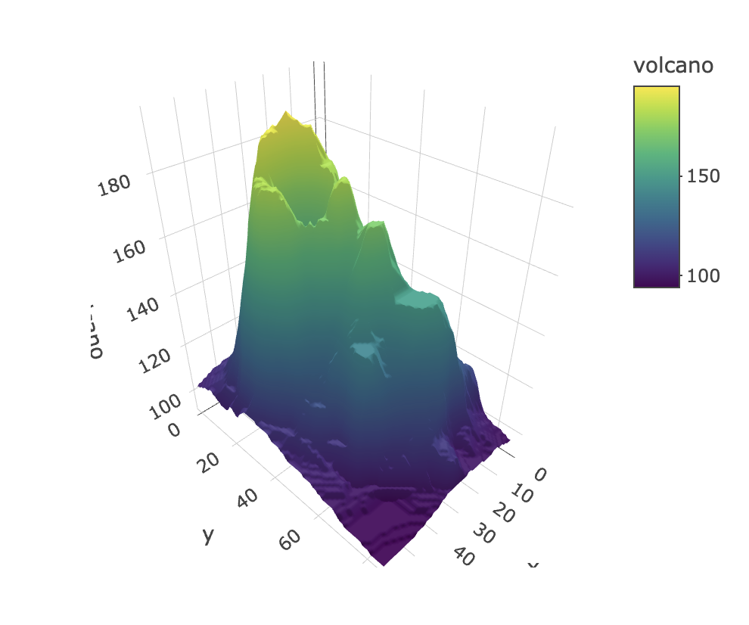
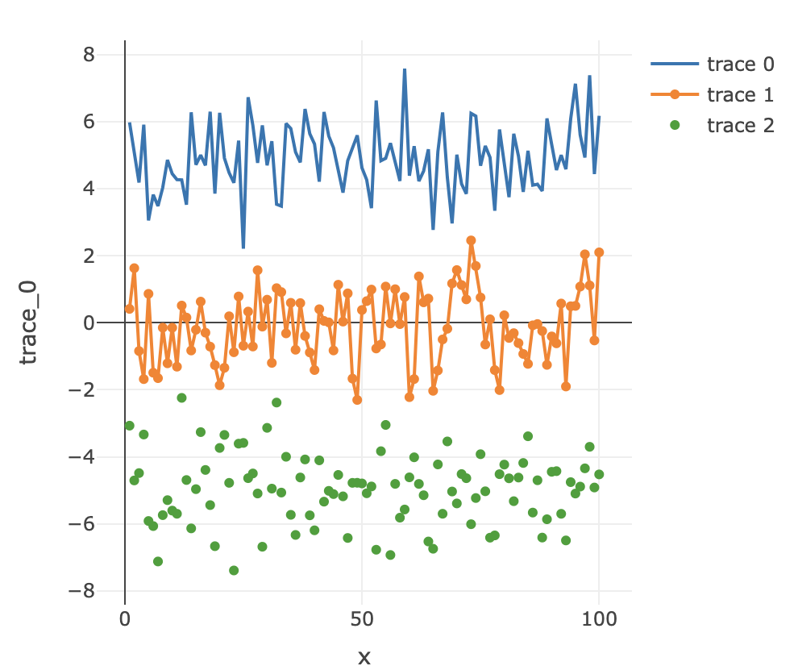

Introduction
Who is Plotly?
Plotly, founded in 2012, is a technical computing company headquartered in Montreal, Quebec
Plotly in R?
Graphing package that makes interactive and intuitive models.
Basic charts (bar, scatterplots) to 3D and animated models
Notes:
Surface plot

Slide 3
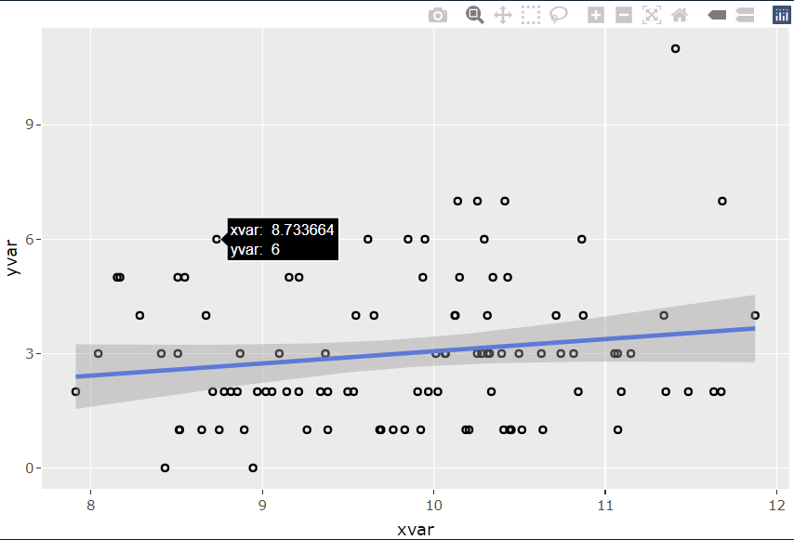
Compatibility
One great function of plotly is its ability to be compatible with some other packages
ggplot2

Slide 4
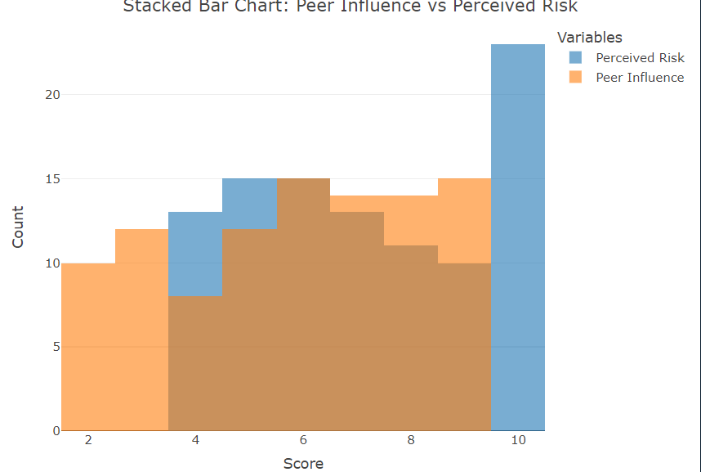
Steroid Data Set (goated)
Created a overlaid histogram
Analysis: Between the scores of 4 and 9, Peer Influence and Perceived Risk are very similar in count. When below 4, Peer Influence dominates that count. On the other hand, Perceived Risk dominates count over 9.

Slide 5
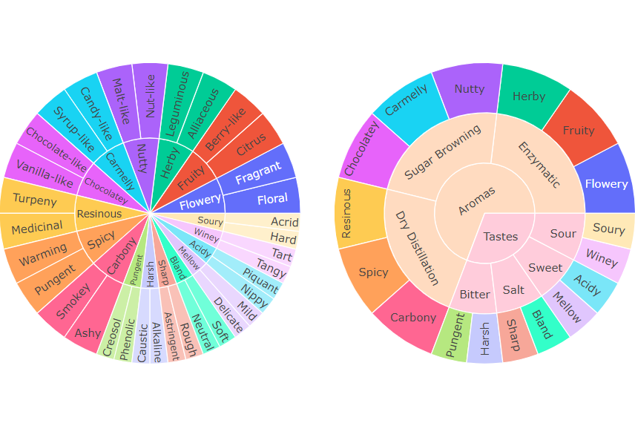
Categorical Data Set
Coffee ;)

Slide 6
Thank you
Q&A

